Slide 1

National safety Day portal
21IT001 AAYUSH PARMAR

Slide 2
Outline
Project Definition
Problem Statement
Major Functionality
Language Used
System flowchart
Implementation

Slide 3
PROJECT DEFINATION
The National Safety Day portal is a site for their employees which make them aware about the particular day/event going at the same time.

Slide 4
Problem Statement
National safety Day portals majorly aims on providing/ make aware of that day and the things we have to keep in mind and understand. It conducts the quiz and its result can also be found in due time to test the knowledge of act as activity for that week and some important announcement can be made for the same.

Slide 5
Major Functionality

Slide 6
National Safety Day portal Has a role-based login for employee.
The key is to reduce the work of IT employees in coding for every such event is going around.
Admin has the full access to the content which has to be provided further and can manipulate it as well.
Each time event is organized then one of the employee manages the event after giving the access to the admin panel.
User can access the link provided by the admin for the same. And know the content of it.

Slide 7
LANGUAGE USED
HTML
CSS
JavaScript
PHP
MySQL

Slide 8
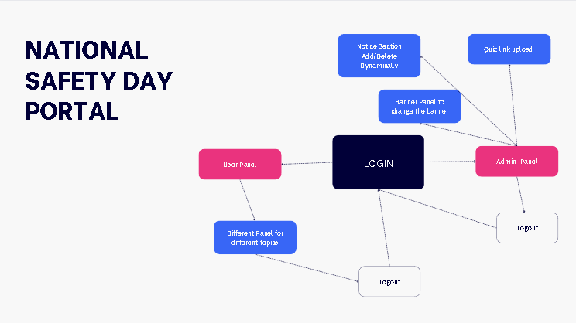
System Flowchart

Slide 9
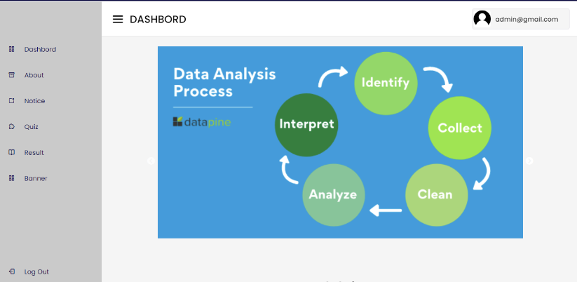
Implementation

Slide 10
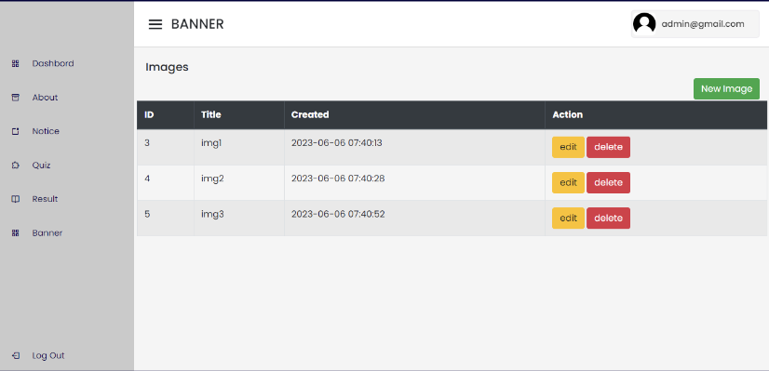

Slide 11
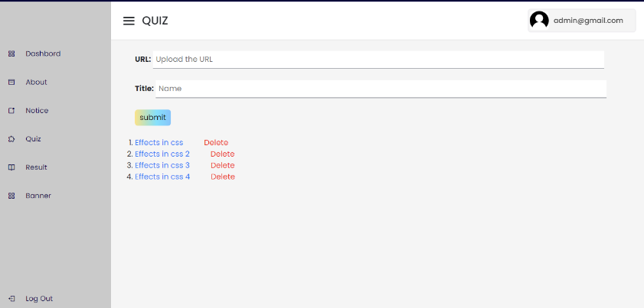

Slide 12
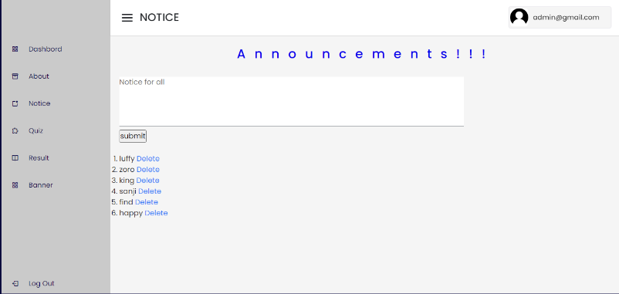

Slide 13
Thank You

